Slide 1
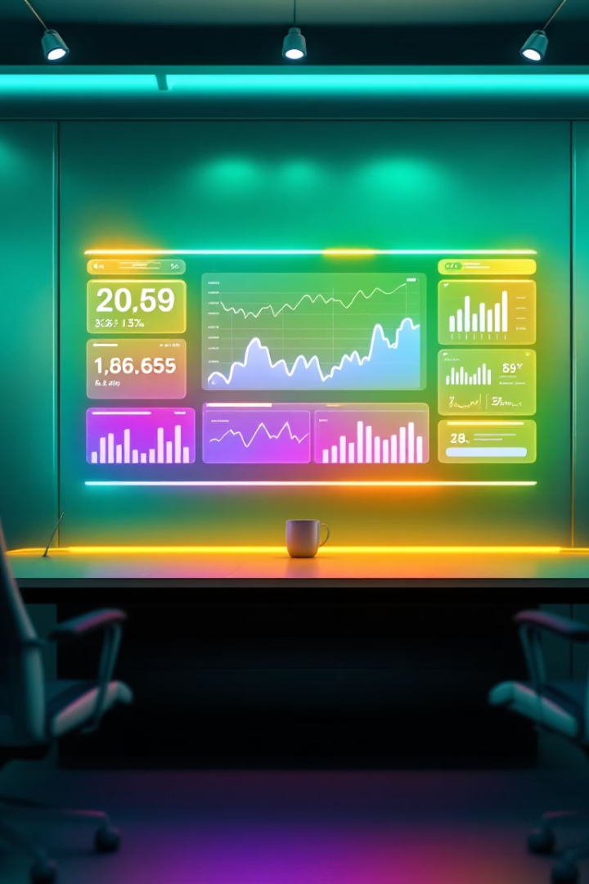


Slide 2
Company Overview
Company Overview
Yahoo, founded in 1994, remains a key digital player.
Acquired by Apollo Global in 2021 for $5B.
Business Areas: Ads, Content, Mail, Finance.
User Base: 900M+ monthly users.

Slide 3


Slide 4








Textual Analysis
Textual Analysis
Sentiment Score: 81/100
Themes: Growth, AI, innovation
Earnings Call: Strong outlook
Media: Favorable digital coverage
Source: 1,500+ articles & transcripts

Slide 5






Slide 6
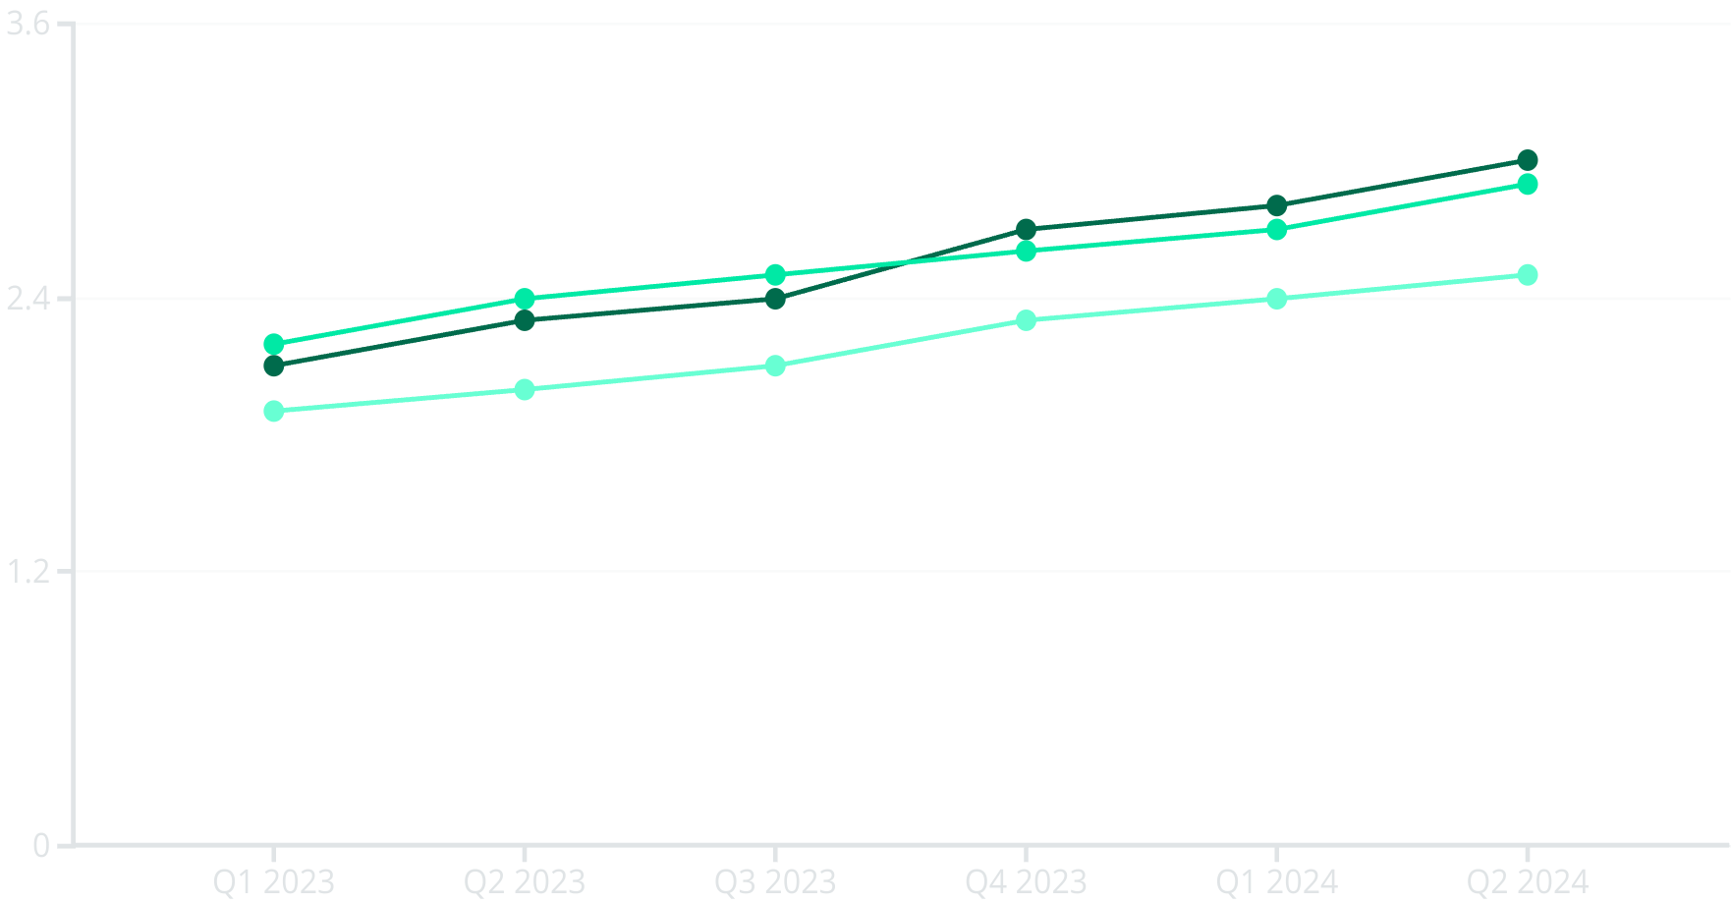
Market Performance Forecast
Market Performance Forecast
Revenue Forecast: +14% vs market
Recommendation: BUY
Time Horizon: 2–3 years
Expected Return: 24–30%
Risk: Moderate
Strategy: Quarterly review and rebalance

Slide 7








Investment Recommendation
BUY Rating
Time Horizon: 2-3 Years
Current valuation presents an attractive entry point
Long enough to realize strategic benefits
Risk Assessment: Moderate
Expected Return: 22-28%
Diversified operations provide stability
Above market average with moderate risk
We recommend a BUY position with quarterly portfolio rebalancing. Yahoo's strategic initiatives and market position justify cautious optimism.

